Slide 1
128K x 8 CMOS Static RAM
Under the guidance of Dr. Kaushik Saha
Team Members:
Shashank Varshney
Vijay Sharma
Saurabh Mathur
Srishti Gupta
Ramyani Mukherjee

Slide 2
Memory Specifications
128K X 8 bit CMOS Static RAM (Cypress Semiconductors CY7C1019CV33
Key Features: Automatic Power down when deselected
Address Width : 17 bit (A0-A16)
Data Width: 8 bit (I₀/O₀- I₇/O₇)
Operating Voltage : 1V + 10%
Operating Temperature: Commercial (0º- 70º C)
Technology Node: UMC 65nm
Cycle Time : 15 ns (min)
Address to Data valid time : 15ns (max)

Slide 3
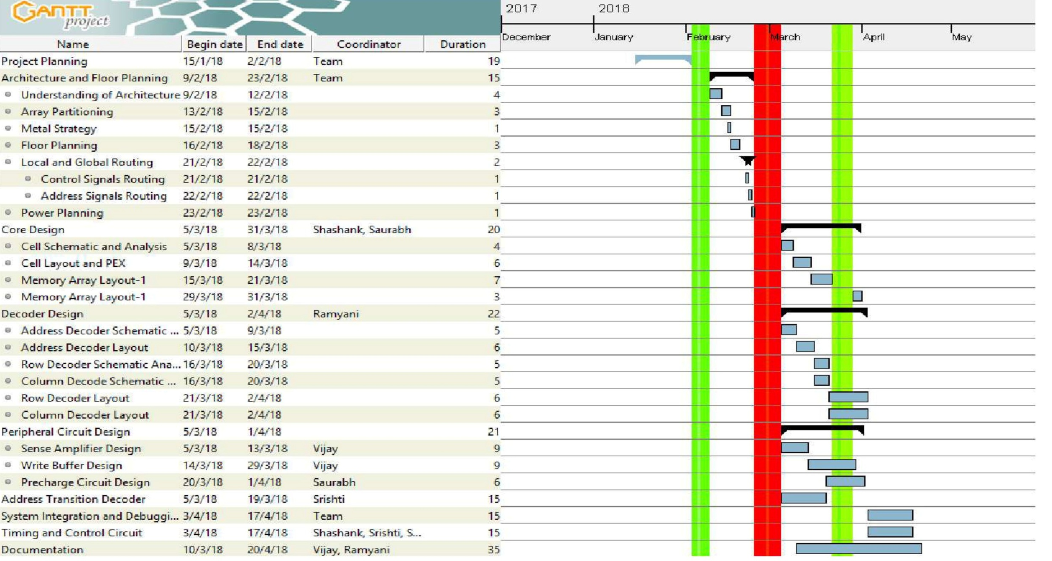
Gantt Chart

Slide 4
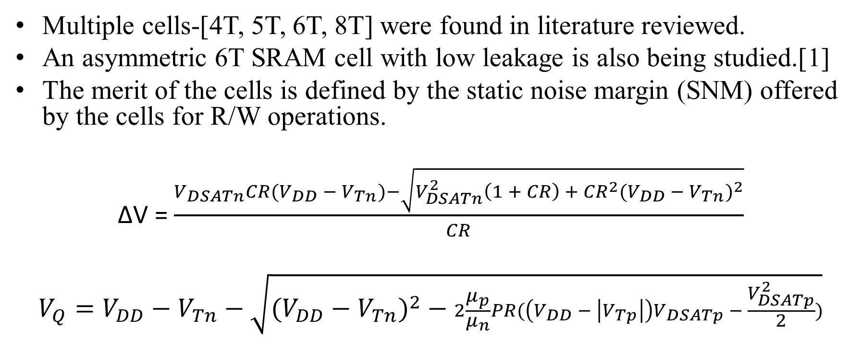
The SRAM Cell
Multiple cells-[4T, 5T, 6T, 8T] were found in literature reviewed.
An asymmetric 6T SRAM cell with low leakage is also being studied.[1]
The merit of the cells is defined by the static noise margin (SNM) offered by the cells for R/W operations.
∆V = $\frac{V_{DSATn}CR(V_{DD} −{ V}_{Tn})−\sqrt{V_{DSATn}^{2}\left(1 + CR\right) +{ CR}^{2}{(V_{DD }− V_{Tn})}^{2}}}{CR}$
$$V_{Q}=V_{DD}−V_{Tn}−\sqrt{{(V_{DD}−V_{Tn})}^{2} − 2\frac{μ_{p}}{μ_{n}}PR(\left(V_{DD} − \left|V_{Tp}\right|\right)V_{DSATp} − \frac{V_{DSATp}^{2}}{2})}$$

Slide 5
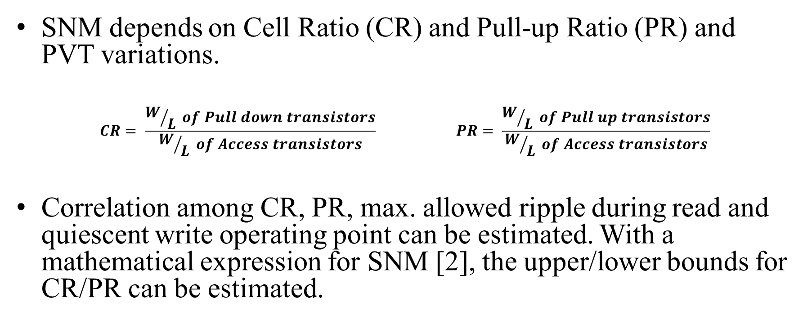
Contd.
SNM depends on Cell Ratio (CR) and Pull-up Ratio (PR) and PVT variations.
$$CR= \frac{W/L of Pull down transistors}{W/L of Access transistors} PR= \frac{W/L of Pull up transistors}{W/L of Access transistors}$$
Correlation among CR, PR, max. allowed ripple during read and quiescent write operating point can be estimated. With a mathematical expression for SNM [2], the upper/lower bounds for CR/PR can be estimated.

Slide 6
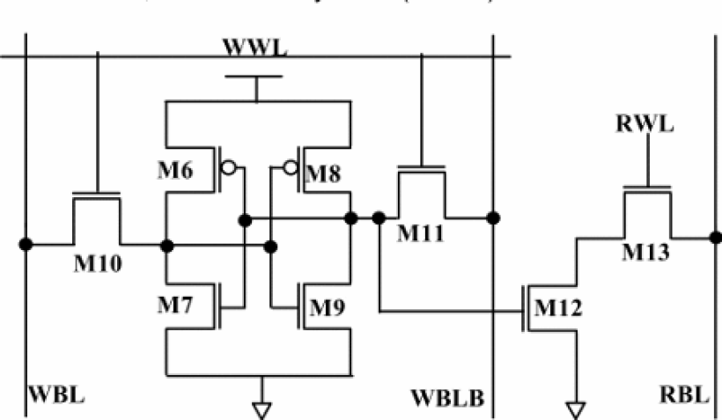
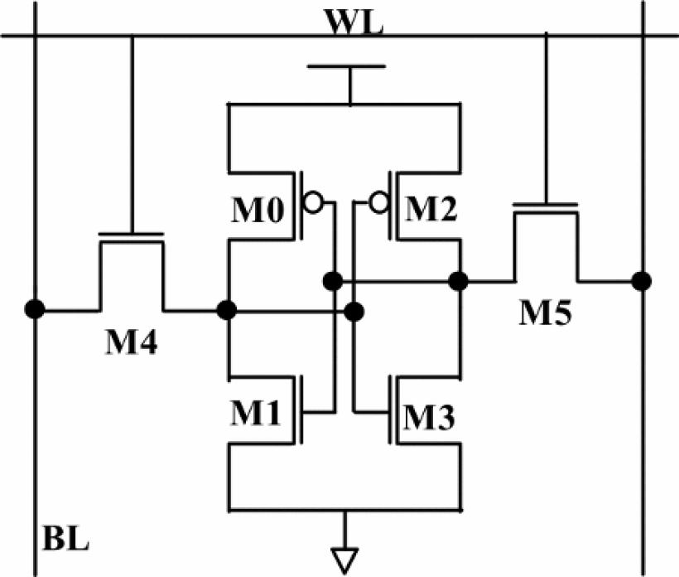
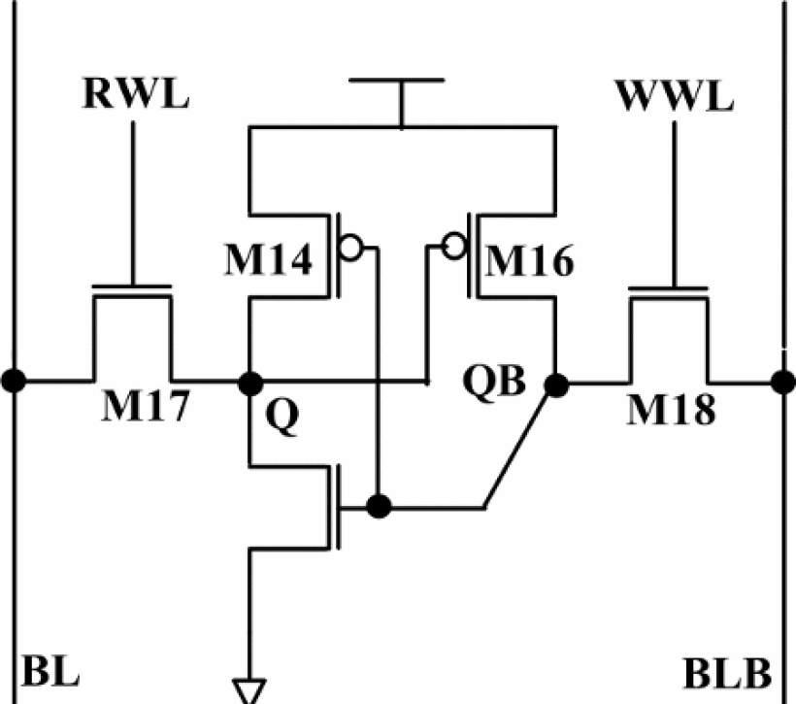
SRAM Cell topologies
(a)
(b)
(c)
Fig. 1 SRAM Cell Topologies a) 8T Cell b) 6T Cell c) 5T Cell
Ref. Anupreet Gupta, Hajra Anwer, B.S. Reniwal, S.K. Vishvakarma “Analysis of Stability Issues and Power Efficiency of Symmetric and Asymmetric Low Power Nanoscaled SRAM cells,” presented at the 2nd International Conference on Devices, Circuits and Systems (ICDCS), 2016.

Slide 7
Comparison of different of SRAM cells
Parameters | 5T Cell | 6T Cell | 8T Cell
RSNM (mV) | 202.8 | 135.5 | 340.9
WSNM (mV) | 380.7 | 347.5 | 346.4
HSNM (mV) | 300.4 | 311.2 | 312.3
Read Power(uW) | 9.4 | 17.2 | 9.3
Write Power(nW) | 39.2 | 39.1 | 39.3
Static Power(nW) | 0.21865 | 5529.77 | 5529.8
Ref. Anupreet Gupta, Hajra Anwer, B.S. Reniwal, S.K. Vishvakarma “Analysis of Stability Issues and Power Efficiency of Symmetric and Asymmetric Low Power Nanoscaled SRAM cells,” presented at the 2nd International Conference on Devices, Circuits and Systems (ICDCS), 2016.

Slide 8
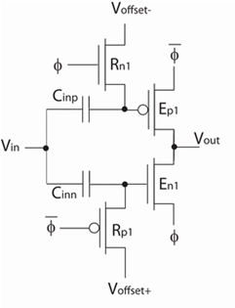
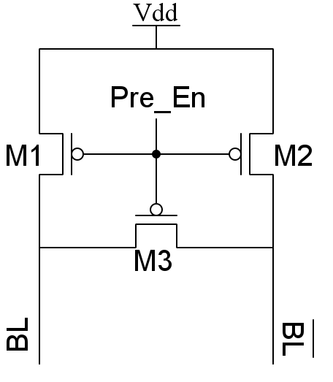
Pre-charge logic
Circuit implementations of different kinds were found.
A simple static version and a complete CMOS dynamic logic implemented version were studied. [1,4]
(a) (b)
Fig. 2 (a)A simple static pre-charge circuit
(b) Dynamic ultra low-voltage domino inverters.

Slide 9
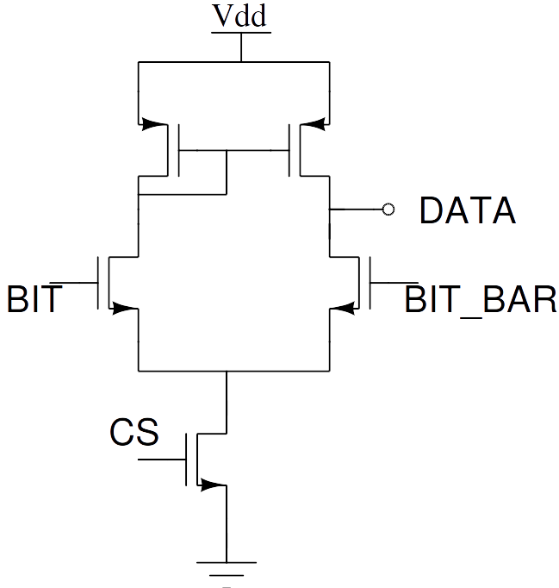
Sense amplifier
Sense amplifiers are basically differential amplifiers with high CMRR and can have a low gain of about 10.
There are multiple topologies which can be used to make a sense amplifiers which were studied.
A simple dual input single ended output differential amplifier can be used for this purpose.
Fig 3. Dual input single ended output differential amplifier

Slide 10
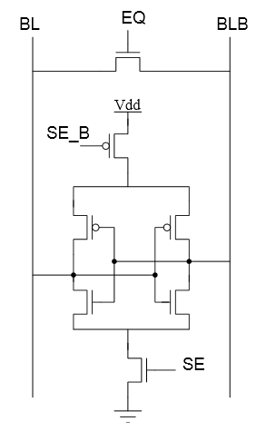
Contd.
A different approach is to use two inverters tied back to back .
An interesting fact about sense amplifiers is that we are not limited on the output voltage swing[4]

Slide 11
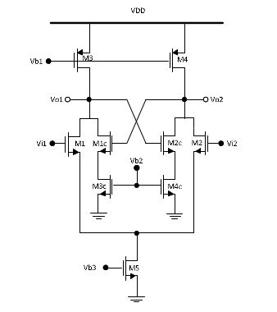
Contd.
This property can be exploited by using a positive feedback network incorporated in a classical analog differential amplifier.
Such a network was studied which used a cross coupled pair as a regenerating circuit.
Spice simulation of these three shortlisted candidates for making the sense amplifiers are to be carried out and the final decision is to be made based on the simulation results.[5]

Slide 12
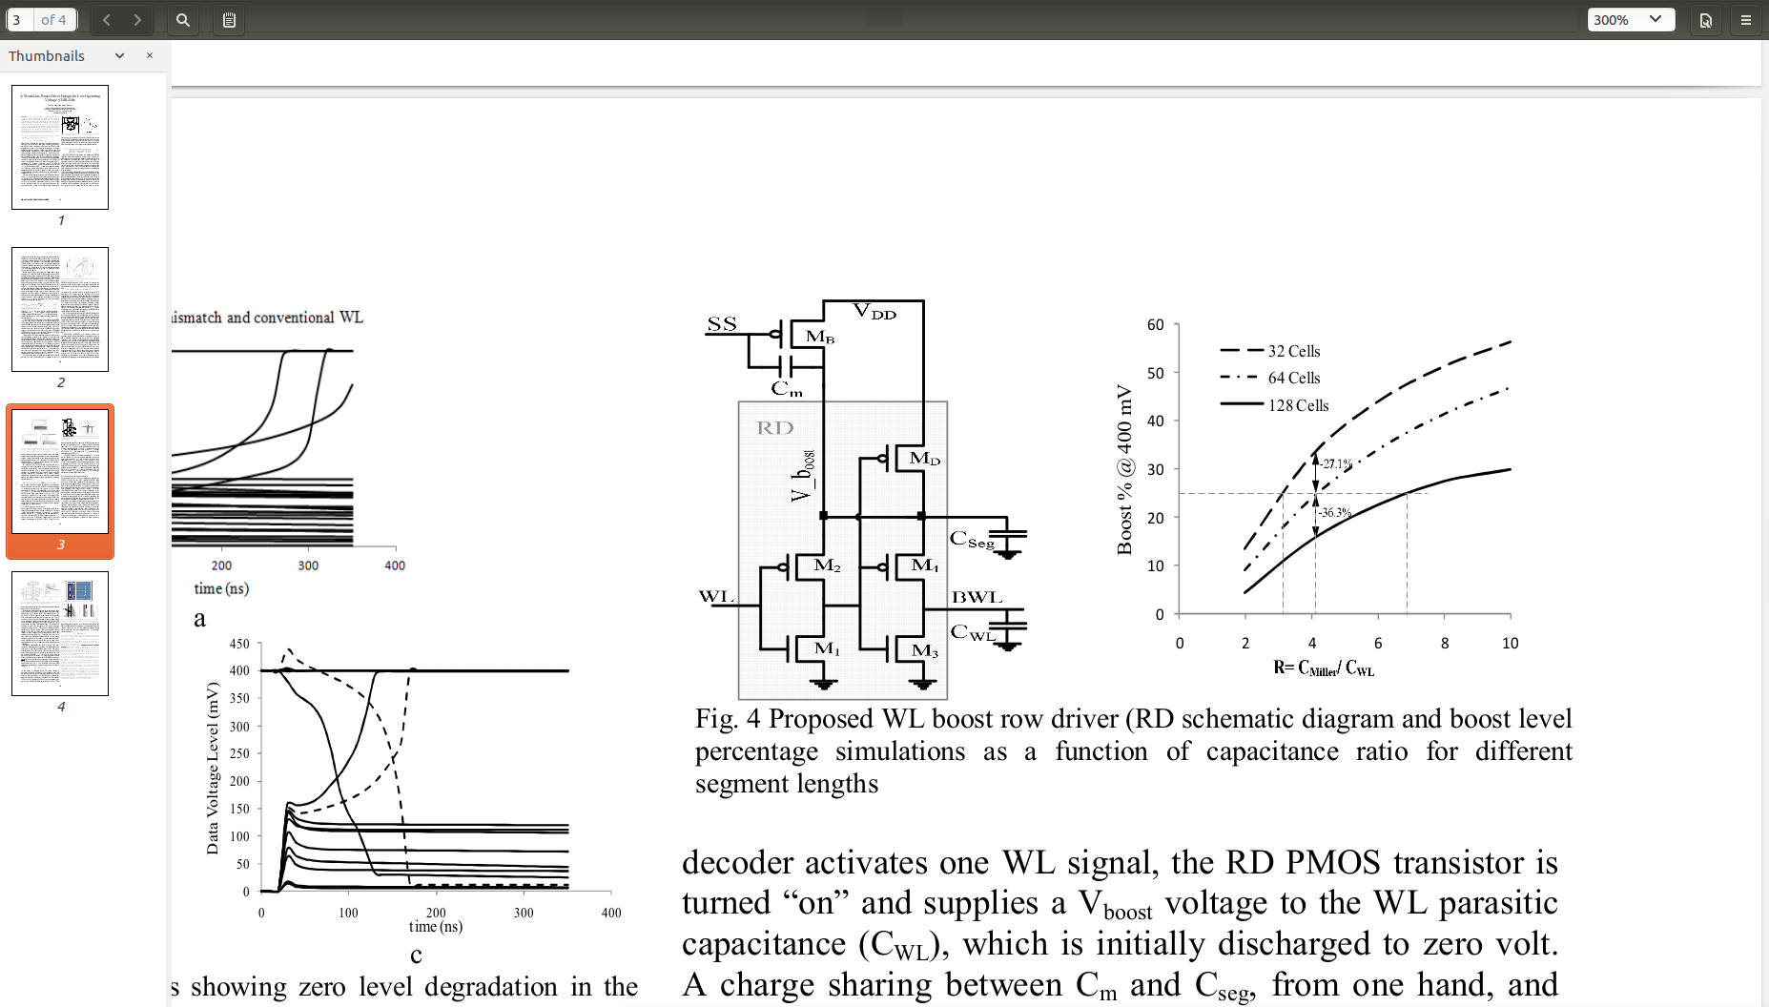
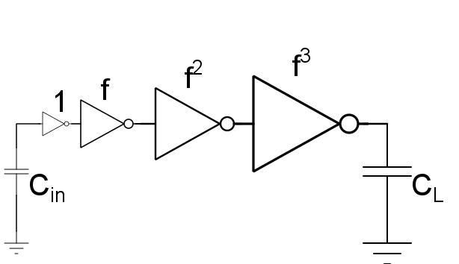
Word Line Driver
Increasing the access transistor strength helps in increasing the cell drivability (RDM) and the WRM.
This can be done by increasing the transistor overdrive voltage by boosting the world line.[8]

Slide 13
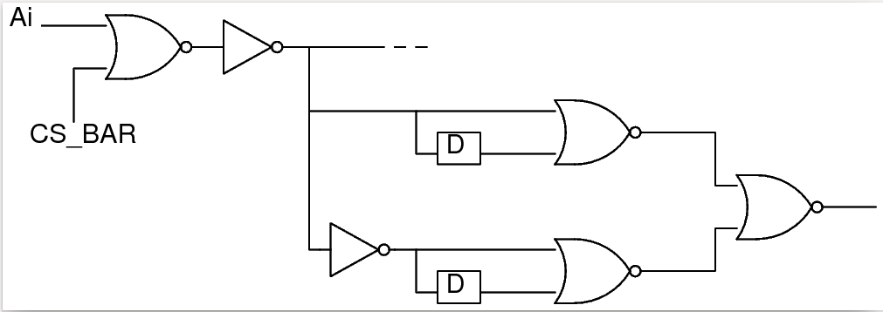
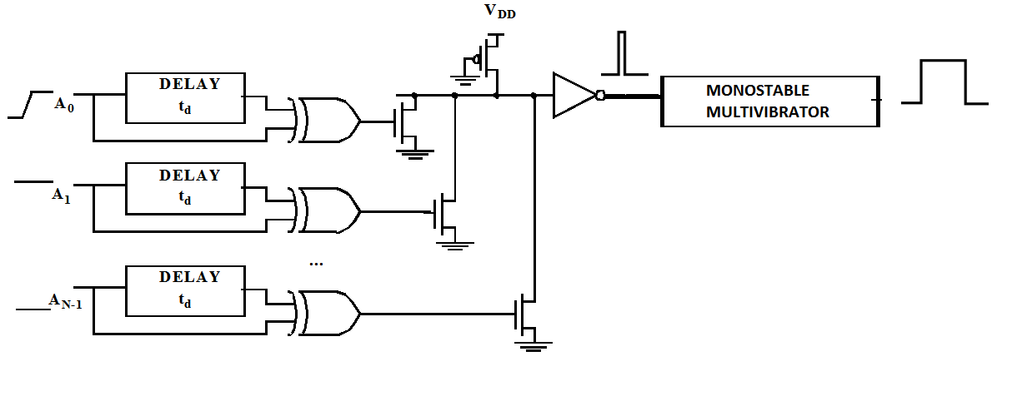
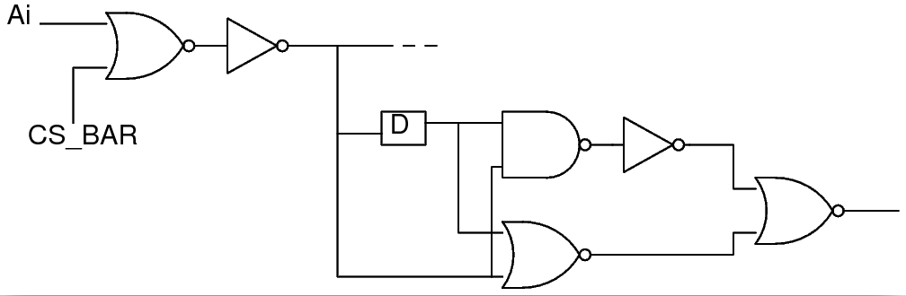
Address Transition Detector
ATD generates a short pulse every time there is a change in any of the address lines.
This pulse triggers the generation of a clock which makes the other blocks execute in the required sequence.[4] [7]

Slide 14
Decoder Circuitry
A hierarchical decoding scheme will be used to select the memory banks, wordlines and bitlines.
Pre-decoding to be done before decoding to reduce fan-in and delay.
Block Decoder for memory bank selection
Row Decoder for wordline selection
Column Decoder for bitline selection
Decoding circuitry can either be:
-Traditional using AND gates
-Novel decoder using stages of NAND and NOR gates and a replica inverter delay chain. This can reduce delay and power dissipation[6].

Slide 15
128K x 8 CMOS Static RAM
Under the guidance of Dr. Kaushik Saha
Team Members:
Shashank Varshney
Vijay Sharma
Saurabh Mathur
Srishti Gupta
Ramyani Mukherjee

Slide 16
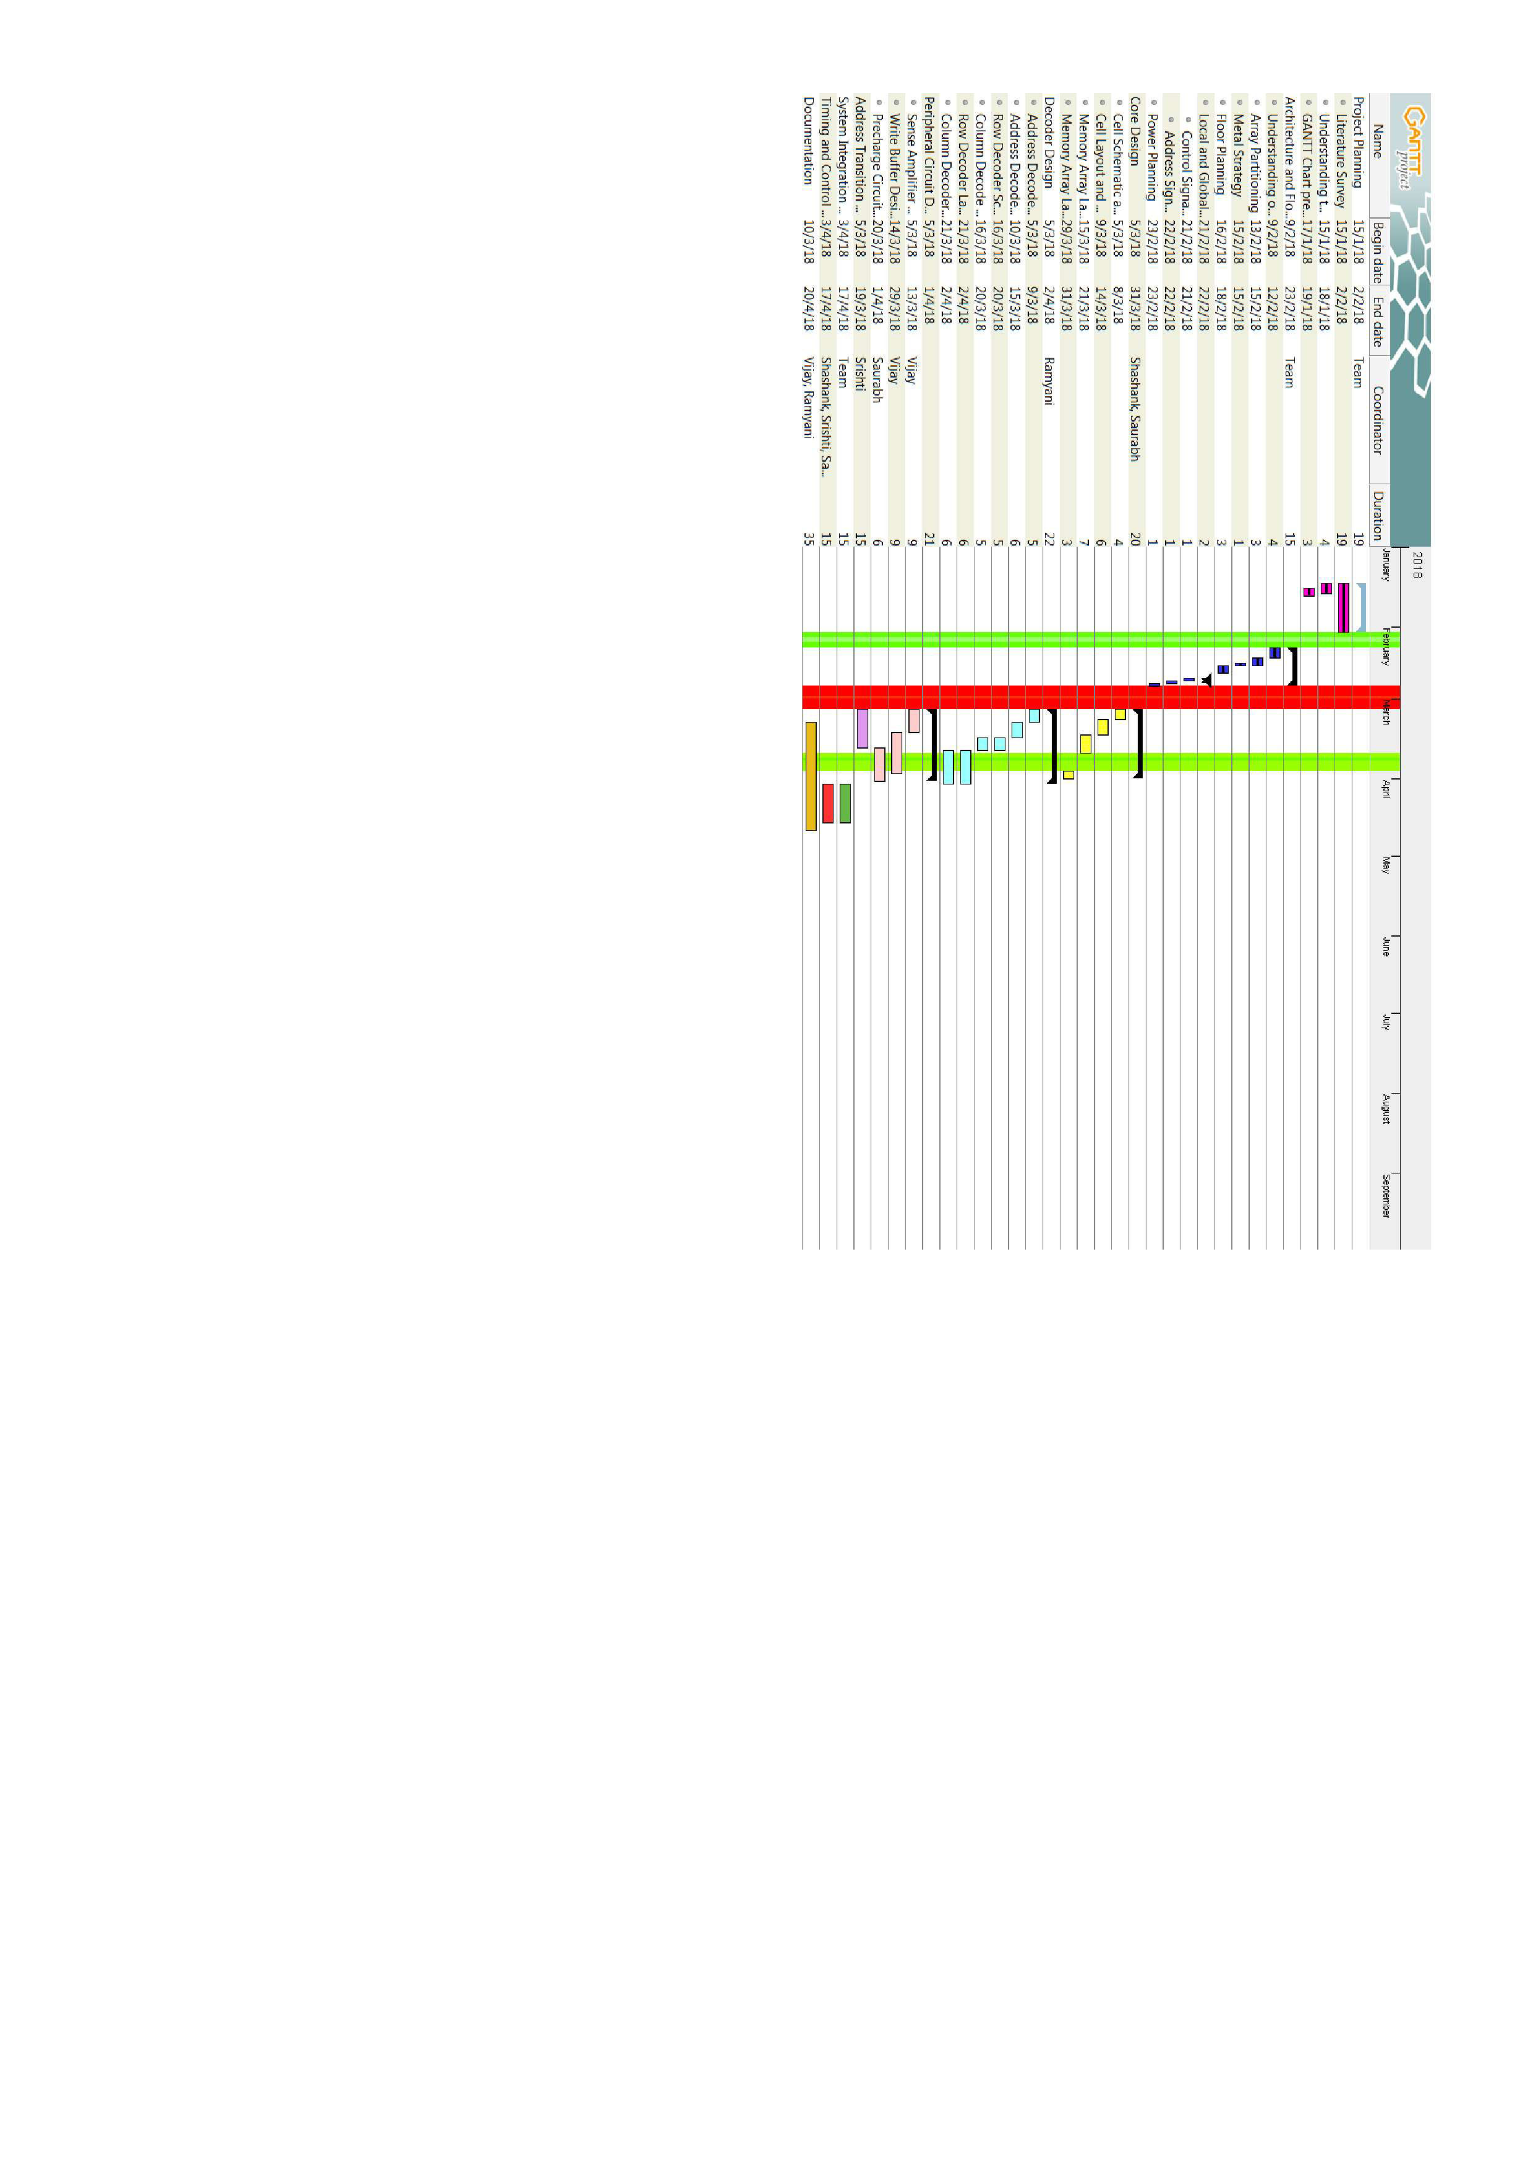

Slide 17
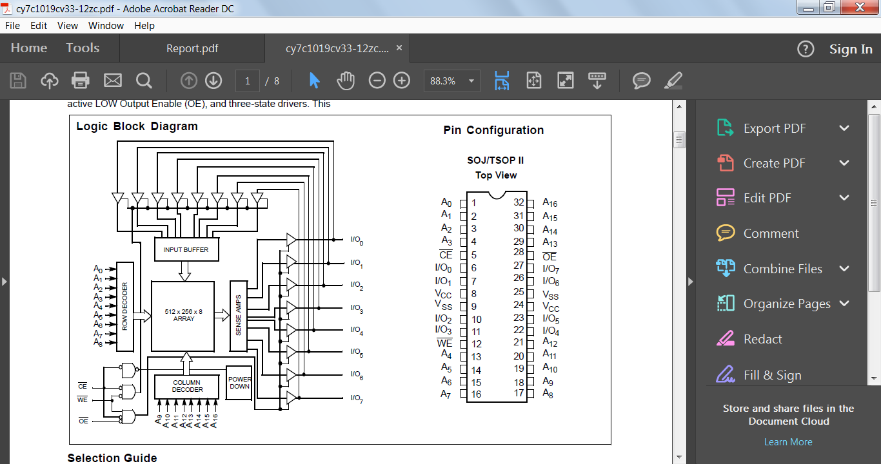
Pin Configuration
Pin Configuration

Slide 18
Metal Planning
Layers | Application | Resistance(sheet)(mῼ) | Capacitance( aF/μm)
Metal Layer 1 | Local Routing | 170 | 130.8
Metal Layer 2 | Word Line Strapping | 150 | 103.7
Metal Layer 3 | Bit Line | 150 | 86
Metal Layer 4 | Bit Line Complement | 150 | 76.5
Metal Layer 5 | Address Routing | 150 | 69.4
Metal Layer 6 | Control Routing | 150 | 69.4
Metal Layer 7 | VSS | 70 | 62.7
Metal Layer 8 | VDD | 70 | 68.3

Slide 19
Array Partitioning
t_{AA} = 10ns
Considering 2ns delay for I/O pad wire bond to package.
Dividing 8 ns equally among 4 major components for rough analysis, core delay = 2ns.
Assuming equal delay in rows and columns,
Row delay = 1ns
Column delay = 1ns

Slide 20
Array Partitioning

Slide 21
Array Partitioning
256 columns
Plotting the delays with respect to size, we get
Rows = 1150 & Columns = 264
This gives a size of 128x8 rows and 256 columns to be appropriate
However for improving speed we prefer smaller bank size to have smaller word line and bit line capacitances.
Therefore we opt for 8 banks of 16k x 8bits each .
But the decoder logic complexity increases exponentially as the number of banks increases and hence we don’t choose banks of smaller size.
64 X 8 Rows
16k X 8

Slide 22
Floor Planning and Routing

Slide 23



A₀
A₁₆
I
/O
BUFFERS
16K × 8 bit
SRAM Core
16K × 8 bit
SRAM Core
I
/O
BUFFERS
A₁
ROW DECODER
WRITE BUFFER
ROW DECODER
A₁₅
PRECHARGE
SENSE AMPLIFIER
PRECHARGE
SENSE AMPLIFIER
A₂
A₁₄
A₃
COLUMN DECODER
COLUMN DECODER
COLUMN DECODER
COLUMN DECODER
A₁₃
16K × 8 bit
SRAM Core
ROW DECODER
WRITE BUFFER
ROW DECODER
16K × 8 bit
SRAM Core
I/O₀
PRECHARGE
SENSE AMPLIFIER
PRECHARGE
SENSE AMPLIFIER
I/O₇
I/O₁
I/O₆
V_{CC}
V_{SS}
TIMING AND CONTROL CIRCUIT
ADDRESS TRANSITION DETECTOR
BLOCK DECODER
V_{SS}
V_{CC}
I/O₂
I/O₅
I/O₃
16K × 8 bit
SRAM Core
16K × 8 bit
SRAM Core
I/O₄
ROW DECODER
WRITE BUFFER
ROW DECODER
PRECHARGE
SENSE AMPLIFIER
PRECHARGE
SENSE AMPLIFIER
A₁₂
A₄
A₁₁
COLUMN DECODER
COLUMN DECODER
COLUMN DECODER
COLUMN DECODER
A₅
A₁₀
A₆
16K × 8 bit
SRAM Core
ROW DECODER
WRITE BUFFER
ROW DECODER
16K × 8 bit
SRAM Core
A₉
PRECHARGE
SENSE AMPLIFIER
PRECHARGE
SENSE AMPLIFIER
A₇
A₈

Slide 24
A₀
A₁₆
I
/O
BUFFERS
16K × 8 bit
SRAM Core
16K × 8 bit
SRAM Core
I
/O
BUFFERS
A₁
ROW DECODER
WRITE BUFFER
ROW DECODER
A₁₅
PRECHARGE
SENSE AMPLIFIER
PRECHARGE
SENSE AMPLIFIER
A₂
A₁₄
A₃
COLUMN DECODER
COLUMN DECODER
COLUMN DECODER
COLUMN DECODER
A₁₃
16K × 8 bit
SRAM Core
ROW DECODER
WRITE BUFFER
ROW DECODER
16K × 8 bit
SRAM Core
I/O₀
PRECHARGE
SENSE AMPLIFIER
PRECHARGE
SENSE AMPLIFIER
I/O₇
I/O₁
I/O₆
V_{CC}
V_{SS}
TIMING AND CONTROL CIRCUIT
ADDRESS TRANSITION DETECTOR
BLOCK DECODER
V_{SS}
V_{CC}
I/O₂
I/O₅
I/O₃
16K × 8 bit
SRAM Core
16K × 8 bit
SRAM Core
I/O₄
ROW DECODER
WRITE BUFFER
ROW DECODER
PRECHARGE
SENSE AMPLIFIER
PRECHARGE
SENSE AMPLIFIER
A₁₂
A₄
A₁₁
COLUMN DECODER
COLUMN DECODER
COLUMN DECODER
COLUMN DECODER
A₅
A₁₀
A₆
16K × 8 bit
SRAM Core
ROW DECODER
WRITE BUFFER
ROW DECODER
16K × 8 bit
SRAM Core
A₉
PRECHARGE
SENSE AMPLIFIER
PRECHARGE
SENSE AMPLIFIER
A₇
A₈

Slide 25
A₀
A₁₆
I
/O
BUFFERS
16K × 8 bit
SRAM Core
16K × 8 bit
SRAM Core
I
/O
BUFFERS
A₁
ROW DECODER
WRITE BUFFER
ROW DECODER
A₁₅
PRECHARGE
SENSE AMPLIFIER
PRECHARGE
SENSE AMPLIFIER
A₂
A₁₄
A₃
COLUMN DECODER
COLUMN DECODER
COLUMN DECODER
COLUMN DECODER
A₁₃
16K × 8 bit
SRAM Core
ROW DECODER
WRITE BUFFER
ROW DECODER
16K × 8 bit
SRAM Core
I/O₀
PRECHARGE
SENSE AMPLIFIER
PRECHARGE
SENSE AMPLIFIER
I/O₇
I/O₁
I/O₆
V_{CC}
V_{SS}
TIMING AND CONTROL CIRCUIT
ADDRESS TRANSITION DETECTOR
BLOCK DECODER
V_{SS}
V_{CC}
I/O₂
I/O₅
I/O₃
16K × 8 bit
SRAM Core
16K × 8 bit
SRAM Core
I/O₄
ROW DECODER
WRITE BUFFER
ROW DECODER
PRECHARGE
SENSE AMPLIFIER
PRECHARGE
SENSE AMPLIFIER
A₁₂
A₄
A₁₁
COLUMN DECODER
COLUMN DECODER
COLUMN DECODER
COLUMN DECODER
A₅
A₁₀
A₆
16K × 8 bit
SRAM Core
ROW DECODER
WRITE BUFFER
ROW DECODER
16K × 8 bit
SRAM Core
A₉
PRECHARGE
SENSE AMPLIFIER
PRECHARGE
SENSE AMPLIFIER
A₇
A₈

Slide 26
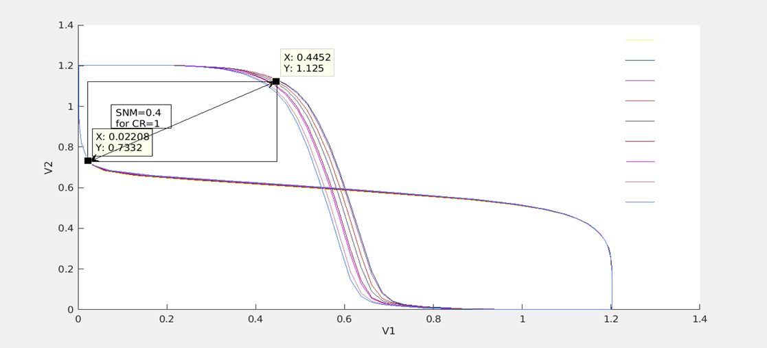
HSNM Calculation
CR=0.5
CR=0.875
CR=0.9
CR=1
CR=1.1
CR=1.25
CR=1.3
CR=1.5
CR=1.625

Slide 27
128K x 8 CMOS Static RAM
Under the guidance of Dr. Kaushik Saha
Team Members:
Shashank Varshney
Vijay Sharma
Saurabh Mathur
Srishti Gupta
Ramyani Mukherjee

Slide 28
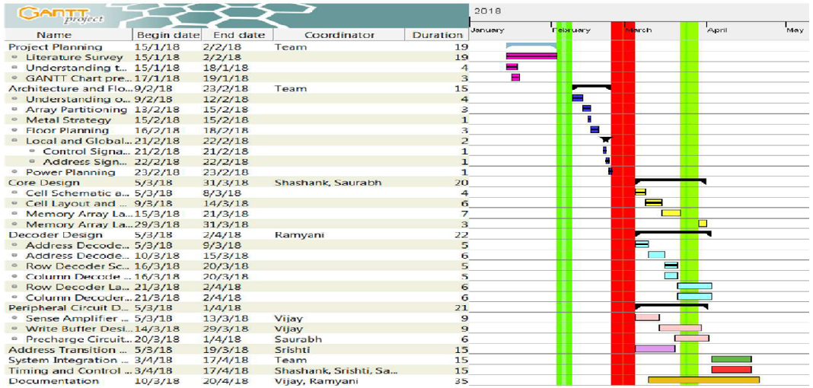

Slide 29
Read Static Noise Margin
CR | RSNM (V)
3 | 0.36
2.5 | 0.314
2 | 0.265
1.5 | 0.224
1 | 0.158

Slide 30
Write Static Noise Margin
PR | WSNM (V)
2 | 0.744
1.5 | 0.66
1 | 0.464
0.5 | 0.445

Slide 31
SNM at Process Corners
For PR=1, CR=2 SNM values at ss corner are:
HSNM=0.3536V
RSNM=0.293V
WSNM=0.432V

Slide 32
Power Planning
Hybrid grid for ground routing on metal layer7
Hybrid grid for VDD routing on metal layer8
Ref- Dr. Robert Reese [9] https://www.google.co.in/url?sa=t&rct=j&q=&esrc=s&source=web&cd=4&cad=rja&uact=8&ved=0ahUKEwjQ3Lemvd_ZAhVLKY8KHcyvBZYQFghLMAM&url=http%3A%2F%2Fece-research.unm.edu%2Fjimp%2Fvlsi_synthesis%2Fcontrib%2FMissStateStdCellTut.ppt&usg=AOvVaw2rM2jRk8ovHWVIv43zPlDs

Slide 33
SRAM Cell sizing
The access transistors were chosen to be of minimum size so as to minimize the bitline capacitance.
Considering acceptable noise margins pull-up ratio was chosen to be 1 and cell ratio was 2.
Optimum CR = 2 & PR = 1.0
Sizing of Transistors : L= 60 nm
Pull-up Transistors : W = 160 nm
Access Transistors : W = 80 nm
Drive Transistors : W = 160 nm

Slide 34
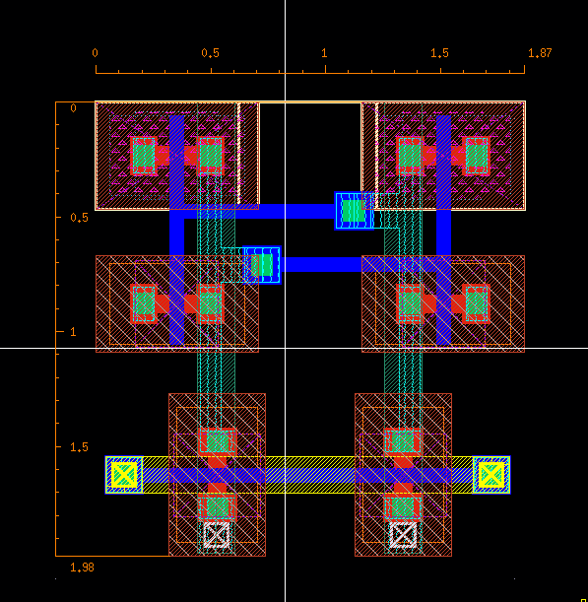
6T Cell Layout
Height=1.98 um
Width=1.87 um
Area= 3.70 um sq

Slide 35
Decoding Scheme
The total 17 address lines are divided as follows for decoding:
-A16 to A14 for memory bank decoding
-A13 to A9 for row decoding
-A8 to A0 for column decoding
A simple 3:8 decoder is to be used for memory bank selection.
A novel 5:32 decoder using a predecoder and an inverter replica based circuit is to be used for row decoding.
The above novel decoder circuit is to be used as a 9:512 decoder for column decoding too.

Slide 36
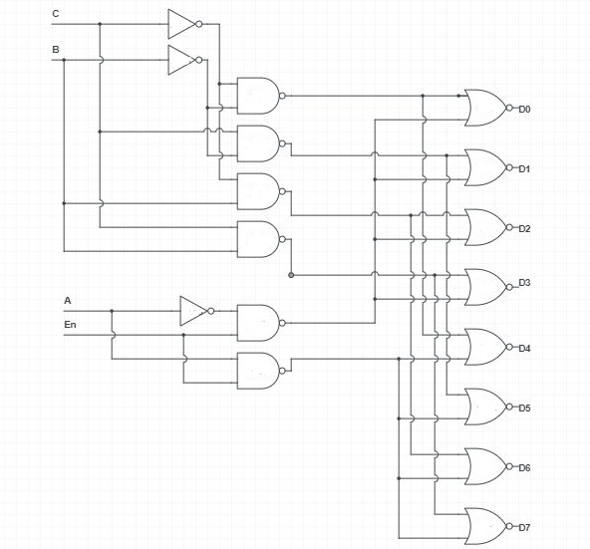
Memory Bank Selection using 3:8 decoder
Predecoding is done to reduce the fan-in of the logic gates.
Using the enable signal at the input stage reduces its fan-out and also minimizes power.
Implemented Schematic of 3:8 Decoder

Slide 37
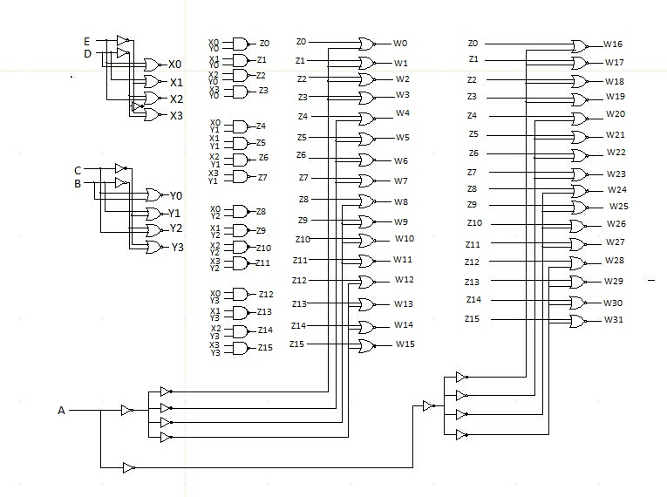
Novel 5:32 Decoder
Ref-[9] “Novel Design Technique of Address Decoder for SRAM ”, Arvind Kumar Mishra et.al, IEEE, 2014

Slide 38
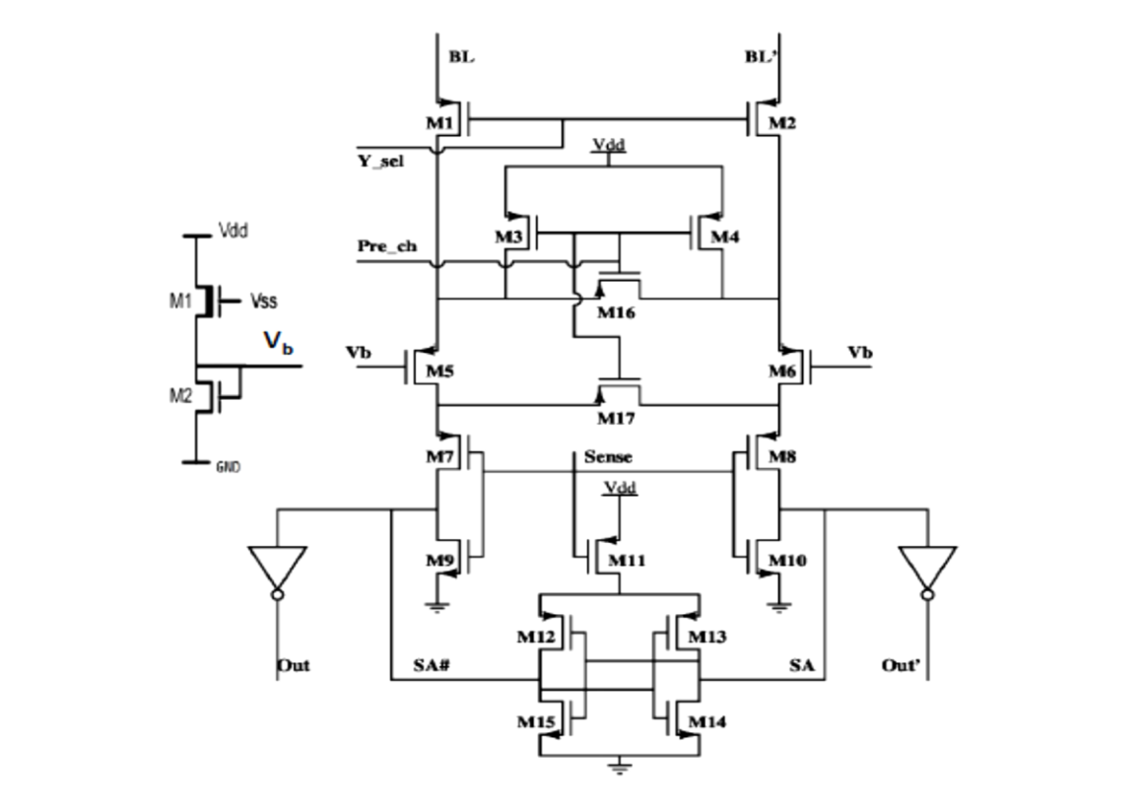
Sense Amplifier
Bias Voltage | Bit(ps) | Bit bar (ps)
0 | 23.59 | 28.1
0.4 | 49 | 20
0.6 | 132 | 67
0.8 | 132 | 132
Ref-[10] “High-Performance and Low-Voltage Sense-Amplifier Techniques for sub-90nm SRAM ”, Manoj Sinha et.al, IEEE, 2003
Table: CTSA delay tplh for bit and bit_bar for various values of bias voltage.

Slide 39
Sense Amplifier
Charge Transfer Sense Amplifier has been chosen.
18-20% faster than Voltage mode sensing. [10]
Works on the principle of conservation of charge and exploits the high bitline capacitances.
Simulations show that there is typically 30ps delay from sense enable signal to output.
The cross coupled inverters raise the signal to full CMOS level.

Slide 40
References
[1] “Low-Leakage asymmetric SRAM Cell”, Azizi et.al. IEEE TVLSI vol.11 no.-4, 2003.
[2] “Static noise margin analysis of SRAM cell”; Seevnick et.al. IEEE JSSC vol.-22 no.-5, 1987.
[3] “Robust low power CMOS Precharge Logic”, Berg et.al. IEEE 2013.
[4] Rabaey, Chandrakasan and Nikolic, “Designing Memory Array Structures” in Digital Integrated Circuits a Design Perspective, 2nd ed.,vol. 1. Noida, Pearson India, 2016, pp. 657-662.
[5] “Gain-Enhancement Differential Amplifier Using Positive Feedback”, Phuoc T. Tran et. al. in MWSCAS, IEEE, 2012.
[6] “Novel Design Technique of Address Decoder for SRAM”, Arvind Kumar Mishra , Debiprasad Priyabrata Acharya , Pradip Kumar Patra, 2014 IEEE International Conference on Advanced Communication Control and Computing Technologies (ICACCCT).
[7] Betty Prince, “Basic Memory Architecture and Cell Structure” in Semiconductor Memory: Design and Application 2nd ed.
[8] “A word-line boost driver designed for Low Operating Voltage 6T- SRAMs” Shakir et.al. MWSCAS- IEEE 2012.

